Slide 1



SAVEETHA SCHOOL OF ENGINEERING
SIMATS, CHENNAI - 602105
THEORY OF COMPUTATION
CSA1331
Team Details :
1 .T.pavani Sandhya(192210369)
2 . R.R.Harshitha(192210215)
3 . Janani(192210315)
SPAM CLASSIFICATION USING NATURAL LANGUGAGE PROCESSING(NLP)

Slide 2
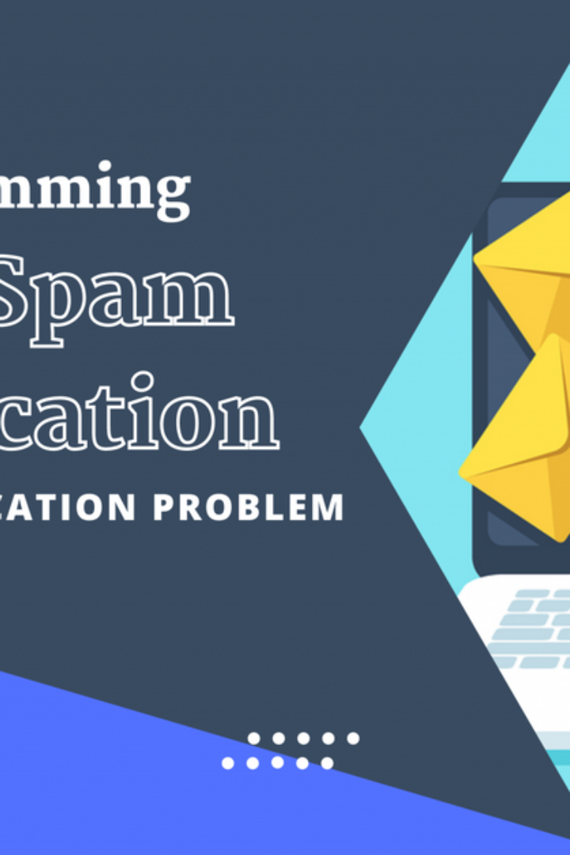
Introduction to Spam Classification
Spam classification involves identifying and categorizing unsolicited messages. This process is crucial for maintaining the integrity of communication platforms and ensuring a positive user experience.

Slide 3
What is NLP (Natural Language Processing)?
Understanding Text Data
Applications
Complex Algorithms
NLP focuses on understanding, interpreting, and generating human language using computational techniques.
NLP is used in machine translation, sentiment analysis, and, most importantly, spam classification.
NLP algorithms process large amounts of data to understand human language patterns and behavior.

Slide 4
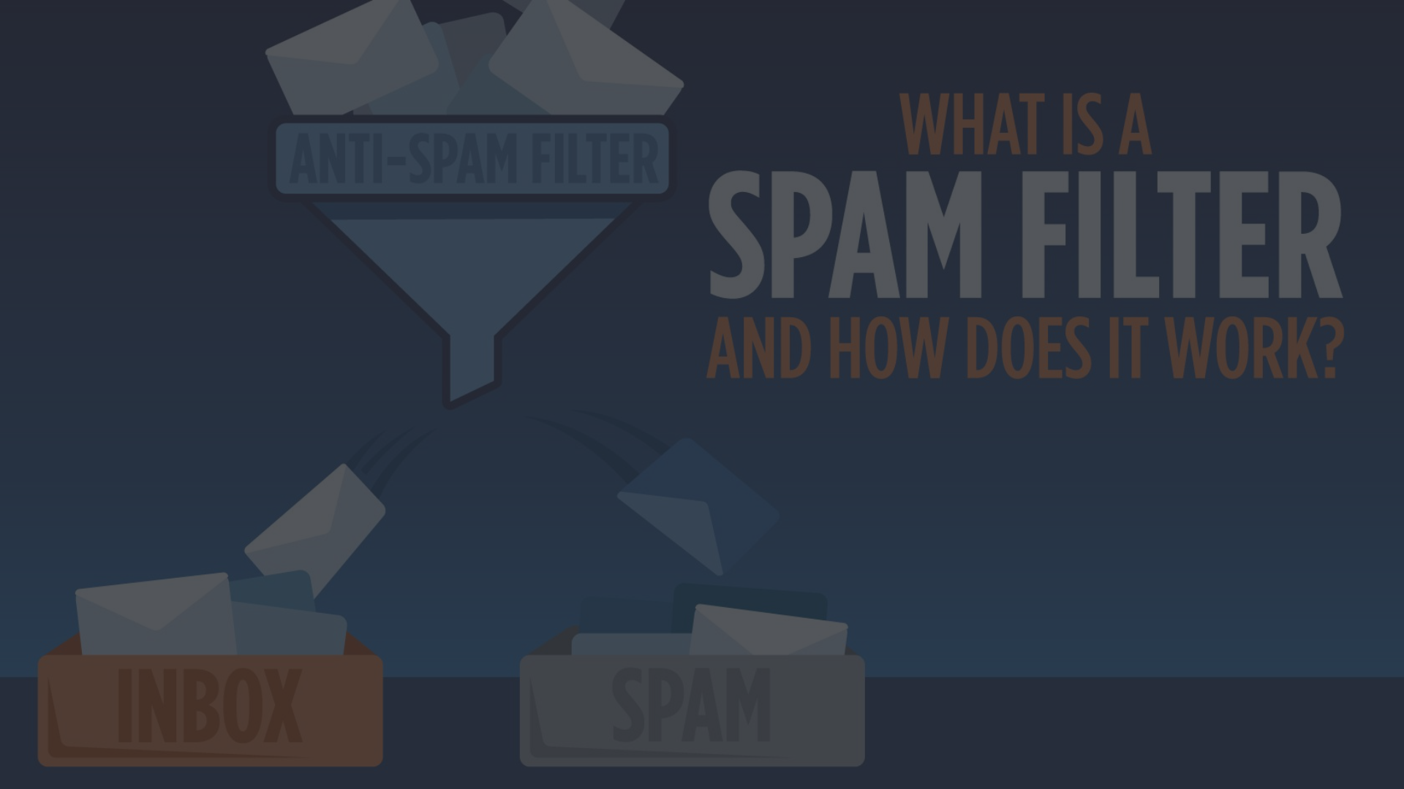
Importance of Spam Classification
1
Protects Users
2
Maintains Platform Integrity
3
Enhances User Experience
Spam classification safeguards users from malicious content, phishing, and scams.
It ensures that communication platforms are clean and free from unwanted content.
By filtering out spam, it improves the overall user experience for platform users.

Slide 5

Techniques used in NLP for Spam Classification
Keyword Filtering
Text Classification
Identifying and filtering messages based on specific keywords and patterns.
Assigning categories to messages based on their content and context.
Machine Learning
Using advanced algorithms to recognize patterns and classify messages.

Slide 6
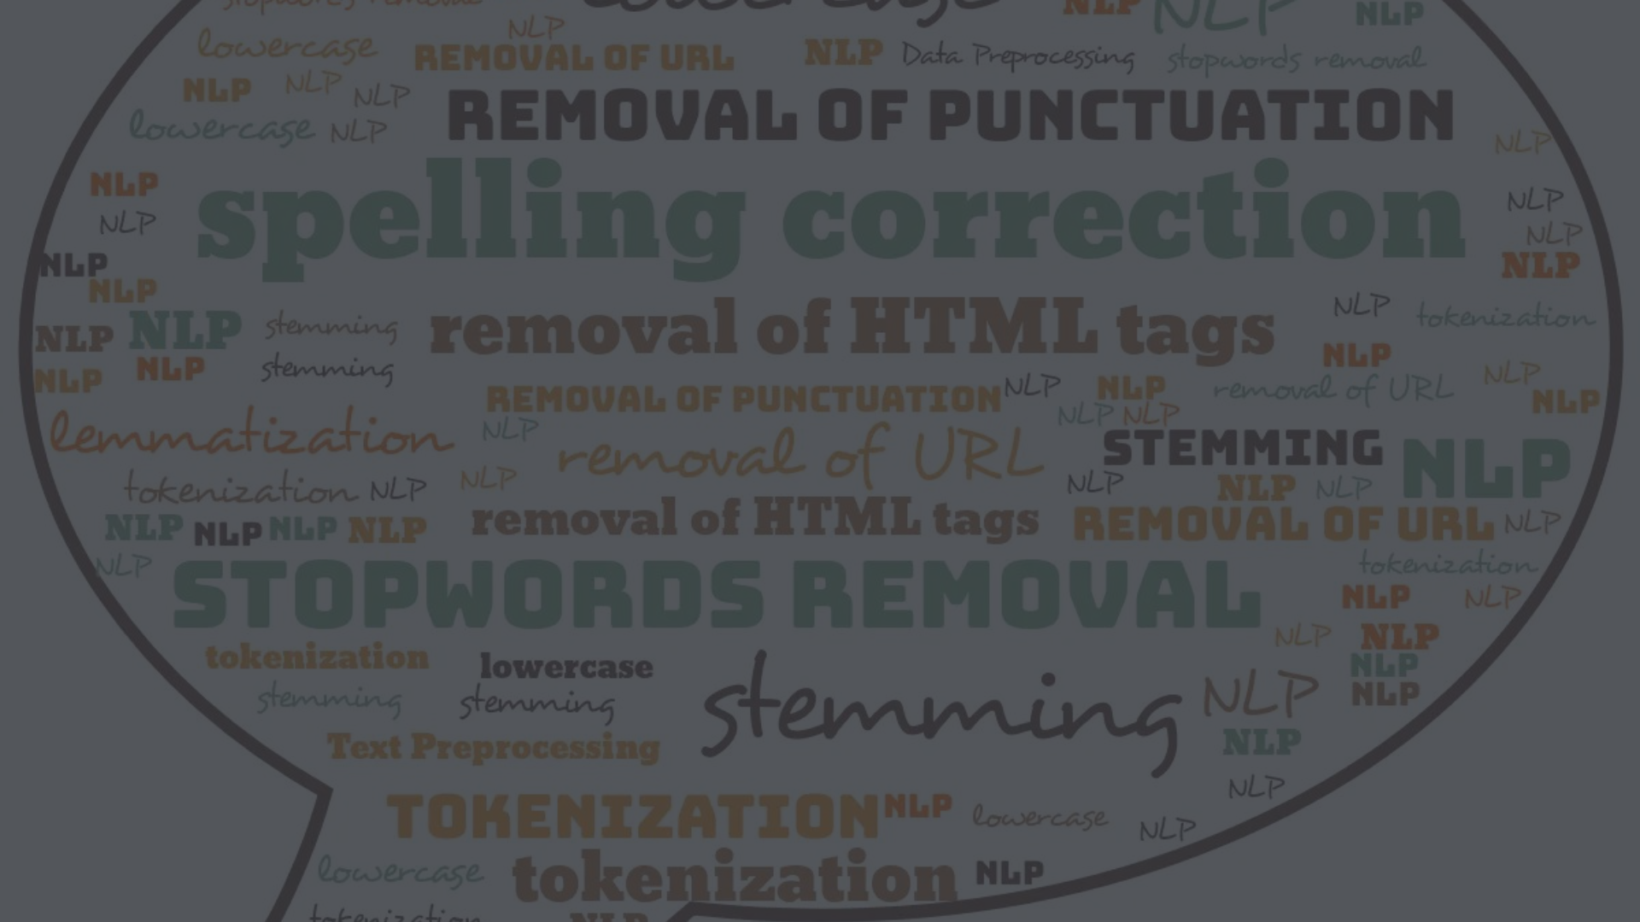



Preprocessing Steps for Text Data
Data Cleaning
Tokenization
Removing Stopwords
Removing irrelevant characters, correcting spelling, and handling capitalization.
Breaking down text into smaller units like words or sentences for analysis.
Filtering out common words that carry little meaning or relevance.

Slide 7
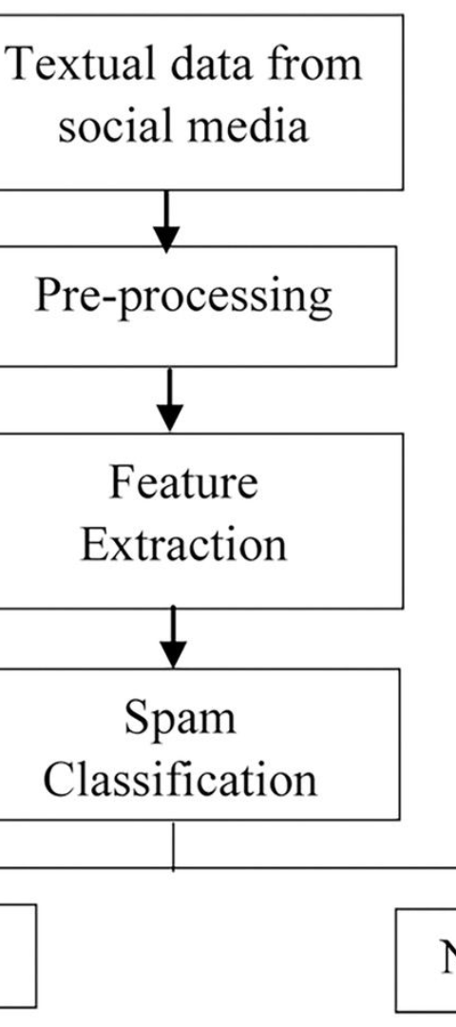
Feature Extraction Methods for Spam Classification
1
Bag of Words
2
N-grams
Creating a vocabulary of all the unique words in the dataset, along with their frequency.
Identifying patterns of words occurring together, providing context and relevance.
3
Word Embeddings
Representing words as high-dimensional vectors to capture semantic meaning.

Slide 8
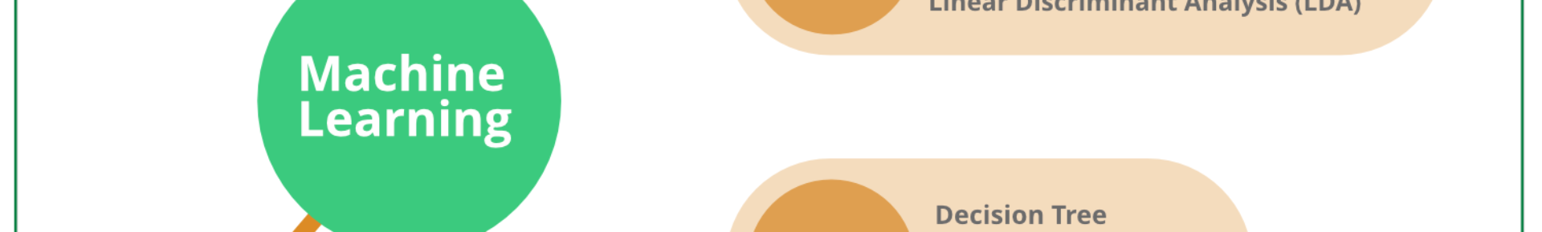
Machine Learning Algorithms for Spam Classification
1
Naive Bayes
A statistical classification technique based on Bayes' theorem with strong independence assumptions.
2
Support Vector Machines (SVM)
Effective for high-dimensional data, using a hyperplane to separate classifications.
3
Random Forest
A robust ensemble learning method that combines multiple decision trees.

Slide 9
Evaluation and Performance Metrics for Spam Classification
Accuracy
Precision
Accuracy
Precision
Measures the proportion of correctly classified messages.
Captures the ratio of correctly identified spam messages to the total spam messages identified.
Recall
F1 Score
Recall
F1 Score
Indicates the proportion of actual spam messages that were correctly identified.
Considers both precision and recall to provide a balanced performance measure.

Slide 10
THANK YOU…
.

